Slide 1
Welcome
to the
Greater Mt. Olive
Missionary Baptist
Church

Slide 2
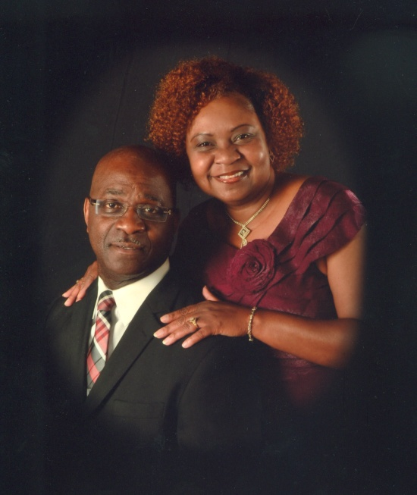
Rev. Elijah Johnson, Jr.
Pastor
and
Sis. Ella Johnson
First Lady

Slide 3
Please remember to put your cell phone on silent.
Thank You!

Slide 4
The Mt. Olive Mass Choir

Slide 5
Welcome 1st time visitors!!
Please kindly fill out a visitors’ card and return it to any usher. Thank you!

Slide 6
Weekly Schedule
Sunday School – 9:30 a.m.
Worship Service – 11:00 a.m.
Prayer (Mon.) – 6:00 p.m.
Bible Study (Mon.) – 7:00 p.m.
Choir Rehearsal (Wed.) – 6:30 p.m.

Slide 7
T-ROC (Teens Relying on Christ)
Monday after the
1st and 3rd Sundays
of each month at 6:00 p.m.
All teens are invited to come!!

Slide 8
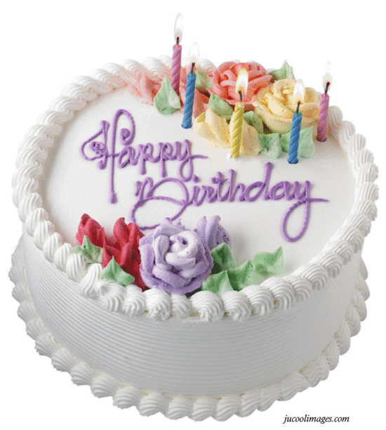
Happy Birthday to everyone celebrating this month!

Slide 9
Welcome New Member
Dahshayelah
We are so happy that you decided to
become a part of our family!

Slide 10
Hey Everyone!!
www.facebook.com/mt.olivebaptistchurchbayminette

Slide 11
Church Covenant
Having been led as we believe by the Spirit of God, to receive the Lord Jesus Christ as our Savior and on the profession of our faith, having been baptized in the name of the Father, and of the Son, and of the Holy Ghost,

Slide 12
we do now, in the presence of God, angels and this assembly most solemnly and joyfully enter into a covenant with one another as one body in Christ.

Slide 13
We engage, therefore, by the aid of the Holy Spirit to walk together in Christian love; to strive for the advancement of this church in knowledge, holiness and comfort; to promote its prosperity and spirituality; to sustain its worship, ordinances, discipline and doctrines;

Slide 14
and to contribute cheerfully and regularly to the support of the ministry, the expenses of the church, the relief of the poor and the spread of the gospel through all nations.

Slide 15
We also engage to maintain family and secret devotions to religiously educate our children; to seek the salvation of our kindred and acquaintances; to walk circumspectly in the world; to be just in our dealings, faithful in our engagements and exemplary in our deportment;

Slide 16
to avoid all tattling, backbiting, and excessive anger; to abstain from the sale and use of intoxicating drinks as a beverage, and to be zealous in our efforts to advance the Kingdom of our Savior.

Slide 17
We further engage to watch over one another in brotherly love; to remember one another in prayer; to aid one another in sickness and distress;

Slide 18
to cultivate Christian sympathy in feeling and Christian courtesy in speech; and to be slow to take offense, but always ready for reconciliation and mindful of the rules of our Savior to secure it without delay.

Slide 19
We moreover engage that when we move from this place we will, as soon as possible, unite with some other church where we can carry out the spirit of this covenant and the principles of God’s word.

Slide 20
New Tabernacle Baptist Church invites us to their 74th Church Anniversary this evening at 3:00p.m.
New Hope Missionary Baptist Church invites us to their Ordination Celebration Service this evening at 3:00 p.m.
St Luke Methodist Church invites us to their Church Anniversary this evening at 3:oo p.m.

Slide 21
Please remember our Sick & Bereaved Families in your prayers.
Sick Sis. Ruby Lee Andrews
Sis. Thelma Reynolds
Sis Vera Lee Bishop
Sis. Ivey Goodley
Sis. Betty Watkins
Sis. Jennie V Robbins

Slide 22
Scripture of the Week…
“The Lord your God is in your midst, a mighty one who will save; he will rejoice over you with gladness; he will quiet you by his love; he will exult over you with loud singing.” (Zephaniah 3:17)

